Slide 1
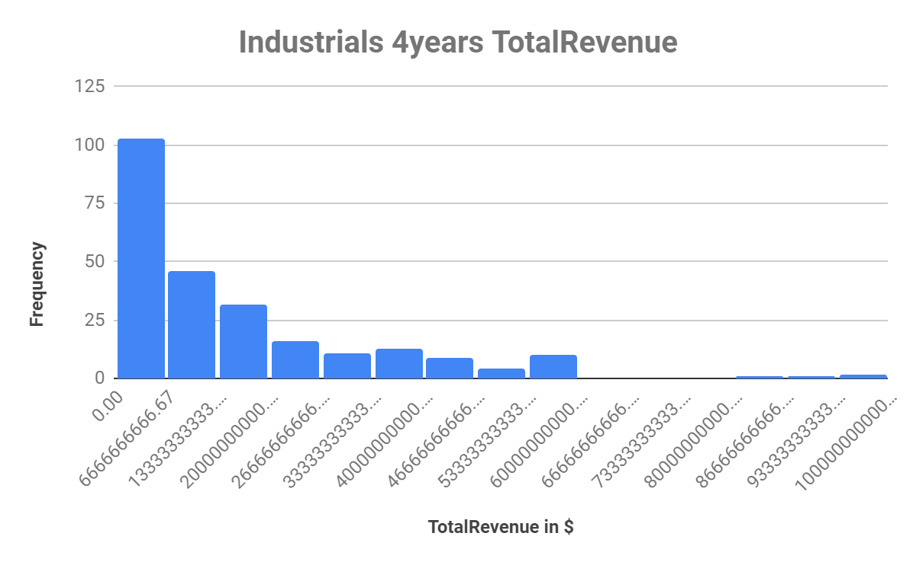
Who has high revenue during 4 years period Real Estate OR Industrials ?

Slide 2
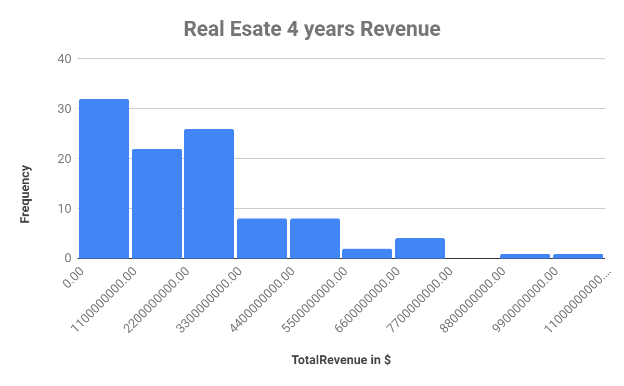

Slide 3
Data Analysis Summary
As you show above in Histograms for 4 years Revenue for 2 different markets Real estate and industrial.
Both histogram shows same patterns right -skewed. So as per study Mean is higher than median.
The average revenue of Industrial market is 16B 8 time it time higher than Real Estate market. It shows as in USA Industrial market is leading compared to real estate market. Although,The Median of industrial is 9.9B it is 4.8 higher than Real Estate. Now look for second perimeter to measure how vast market grow and spread in 4 years time.The range of revenue over 4 years duration time is show industrial market gain 94B over time in USA and Real Estate only is 10B is compare to very low. It indicated the over time Industrial market grow all over USA during that time of period.the standard deviation for industrial market is 17B and real estate is 1.98B. It almost 8 time higher. That show that revenue is the higher for industrial compare to the real estate in USA market. It show us the industrial market is grow over real estate market during 4 year period in USA.

Slide 4
 | Median | Mean | Standard deviation | Range
Real Estate | 2B | 2.5B | 1.98B | 10B
Industrials | 9.9B | 16B | 17B | 94B
Link of Google Sheet → https://docs.google.com/spreadsheets/d/19pbQOgHbiUYbt8YH7XWeBCr-y0pGcciYSKZLxxGGM6E/edit?usp=sharing

